Slide 1

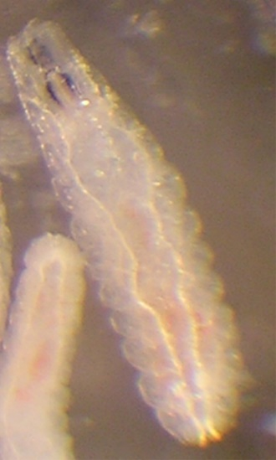
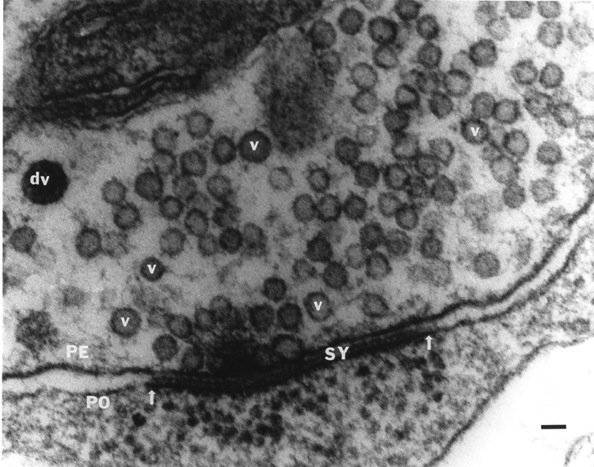
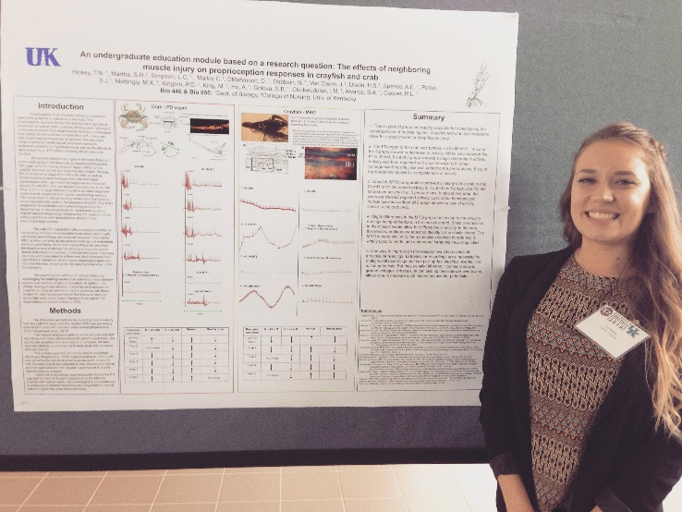
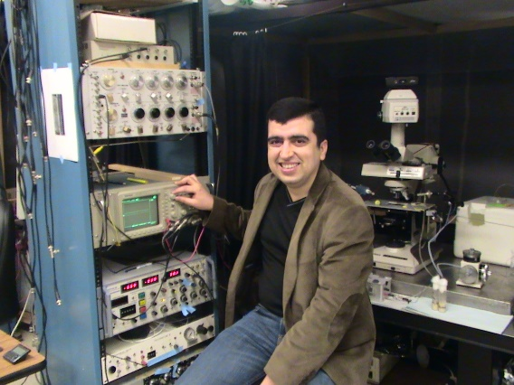
Project:
Desensitization of glutamate receptors at the larval Drosophila
neuromuscular junction as a function of Ca²⁺ in the bath.
People:
Dr. Zana Majeed, College of Science, University of Salahaddin, Erbil, Iraq
Students in Dr. Majeed’s class.
- Bio199 mentors/students

Slide 2
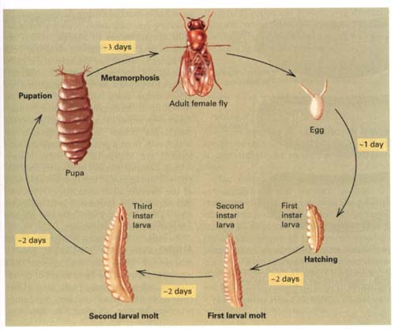
Life Cycle Of Drosophila
1 day
2 day
1 day
1 day

Slide 3
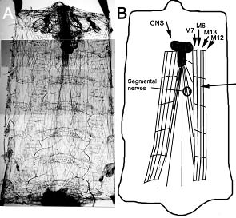

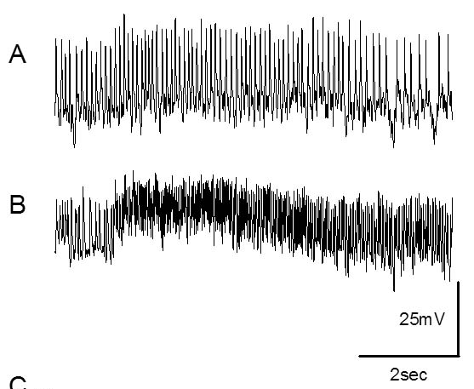
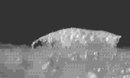
With the CNS intact motor nerves are active

Slide 4
Stimulate motor nerve with electrode
Minis at fly NMJ

Slide 5
Quantal Hypothesis
For Synaptic Transmission
Sir Bernard Katz, German-born biophysicist (1911-2003).
Nobel Prize in physiology or medicine in 1970.

Slide 6
Focal recording
nerve
muscle

Slide 7
Focal recording
Intracellular muscle
recording
Case 1:
nerve
Case 2:
muscle
SINGLE VESICLE EVENT
Case 1:
Case 2:

Slide 8
nerve
muscle
Spontaneous Events
Evoked Events

Slide 9
Evoked Events
BATH:
Low Ca2+
Or
High Mg2+
# of
occurrences
0
1 unit
2 unit
3 unit
Amplitude of events (mV)
or
Area of events (mV x time)

Slide 10
Evoked Events
BATH:
High Ca2+
Or
low Mg2+
# of
occurrences
0
1 unit
2 unit
3 unit
Amplitude of events (mV)
or
Area of events (mV x time)

Slide 11
Spontaneous Events
# of
occurrences
1 unit
Amplitude of events (mV)
or
Area of events (mV x time)

Slide 12
Spontaneous Events
Evoked Events
# of
occurrences
1 unit
Amplitude of events (mV)
or
Area of events (mV x time)
# of
occurrences
0
1 unit
2 unit
3 unit
Amplitude of events (mV)
or
Area of events (mV x time)

Slide 13
Thus:
Quantal Hypothesis for Synaptic Transmission.
Transmitter is stored in packets which are released for synaptic transmission

Slide 14
Neuromuscular Junction
ES
Presynaptic terminal
Synaptic cleft
Glutamate Receptors
Postsynaptic target

Slide 15
Crayfish NMJ (Excitatory “E” as well as inhibitory “I” motor nerve terminals)
“S” is a synapse. Arrows without tail are active zones. Arrows with tails define synapses.

Slide 16
Nerve terminal
glutamate
Muscle fiber
Glutamate receptors

Slide 17
Nerve terminal
glutamate
Muscle fiber
Glutamate receptors

Slide 18
Nerve terminal
glutamate
Muscle fiber
Glutamate receptors

Slide 19
Nerve terminal
glutamate
Muscle fiber
Glutamate receptors
Mostly Na⁺
Some Ca²⁺

Slide 20
Nerve terminal
glutamate
Desensitization
Muscle fiber
Glutamate receptors
Mostly Na⁺
Some Ca²⁺

Slide 21
Nerve terminal
glutamate
Desensitization
Muscle fiber
Glutamate receptors

Slide 22
Nerve terminal
glutamate
Ready to open again
Muscle fiber
Glutamate receptors

Slide 23
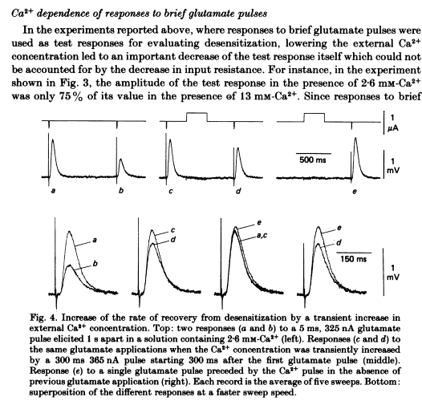
Thieffry M. (1984) The effect of calcium ions on the glutamate response and its desensitization in crayfish muscle fibres. J. Physiol. 355:119-135.

Slide 24
Desensitization
Pre (nerve)
Post (muscle)

Slide 25
Removing desensitization
Wider response
Does this vary with [Ca²⁺] in the bath ?
Hypothesis is : The responses will show more desensitization
with increasing [Ca²⁺] in the bath.

Slide 26
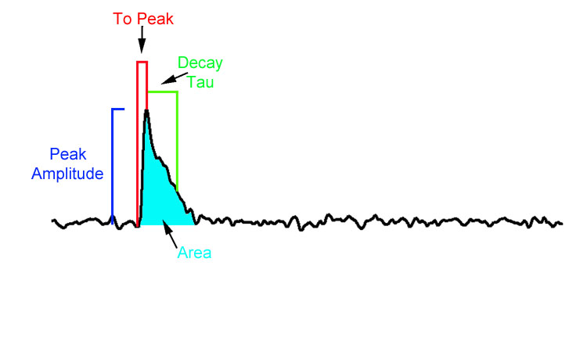
Measures possible:

Slide 27
Actions:
See what the recorded files look like
Get use to software
Try some measures on 10 minis
Think of the best approach to use.
Discuss issues in measures of quantal events.

